Slide 1
PROBLEM SOLVING AND COMPUTER PROGRAMMING
Lecture 05:
Strings - Examples

Slide 2
Programs
Write a program to count number of words in string.
Write a program to concatenate one string contents to another.
Write a program to compare two strings.
Write a program to check whether given string is palindrome or not.
Write a program to find a substring within a string. If found display its starting position.
Write a program to reverse a string.

Slide 3
Strings using User Defined Functions & Pointers
Write a program to find length of the string using user defined functions
Write a Program to copy one string to other using pointers
Program to convert string into lowercase and uppercase without using library function in C++
Program to calculate length of string using pointers

Slide 4
Character 2D arrays
2D character arrays are very similar to the 2D integer arrays. We store the elements and perform other operations in a similar manner. A 2D character array is more like a String array. It allows us to store multiple strings under the same name.

Slide 5
Declaration and Initialization of a 2D character array
A 2D character array is declared in the following manner:
char name[5][10];
  The first subscript [5] represents the number of Strings that we want our array to contain
  The second subscript [10] represents the length of each String.
  This is static memory allocation. We are giving 5*10=50 memory locations for the array elements to be stored in the array.

Slide 6
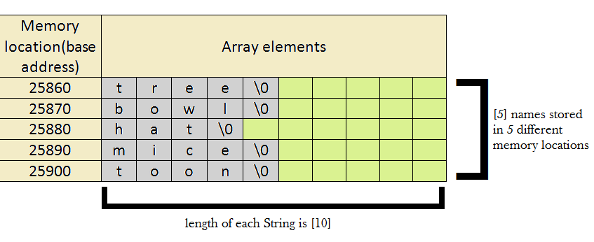
Initialization of the character array occurs in this manner: char name[5][10]={"tree", "bowl", "hat", "mice", "toon“ };

Slide 7
Taking input from user
In order to take string data input from the user we need to follow the following syntax:
    for(i=0 ;i<5 ;i++ )
    cin>>name[i][0];
Here we see that the second subscript remains [0]. This is because it shows the length of the string and before entering any string the length of the string is 0.
So we can also take input as
    for(i=0 ;i<5 ;i++ )
    cin>>name[i];

Slide 8
Printing the array elements
The way a 2D character array is printed in not the same as a 2D integer array. This is because we see that all the spaces in the array are not occupied by the string entered by the user. If we display it in the same way as a 2D integer array we will get unnecessary garbage values in unoccupied spaces. Here is how we can display all the string elements:
    for(i=0 ;i<5 ;i++)
    cout<<name[i];
This format will print only the string contained in the index numbers specified and eliminate any garbage values after ‘\0’.

Slide 9
Example
#include <iostream>
using namespace std;
int main()
{
char colour[4][10] = { "Blue", "Red", "Orange",
"Yellow" };
for (int i = 0; i < 4; i++)
cout << colour[i] << "\n";
return 0;
}

Slide 10
Sorting of words
#include<iostream>
#include<string.h>
using namespace std;
void sort(char s[100][100], int n){ //uses selection sort
char temp[100];
int i,j;
for(i=0; i<n; i++){
for(j=0; j<n; j++){
if (strcmp(s[i], s[j]) < 0){
strcpy(temp, s[i]);
strcpy(s[i], s[j]);
strcpy(s[j], temp);
}
}
}
}

Slide 11
int main()
{ char s[100][100];
int i, n;
cout <<"Enter the number of words:";
cin >> n;
cout << "Enter"<<n<<" words:" << endl;
for(i=0;i < n;i++){
cin.getline(s[i], 100);
}
cout <<endl << "Before sorting";
for(i=0; i<n; i++)
cout << s[i]<<endl;
sort(s, n);
cout <<endl << "After sorting";
for(i=0; i<n; i++)
cout<< s[i]<<endl;
return 0;
}

